Slide 1
Experiment No. 0
Problem Definition: Introduction to Web , HTML
CSE@GIT
6/1/2017
Department of Computer Science and Engineering, GIT

Slide 2
Objectives of the Experiment:
To demonstrate the use of HTML.
To develop an understanding of tags in HTML.
To be able to build simple web pages.
CSE@GIT
6/1/2017
Department of Computer Science and Engineering, GIT

Slide 3
Theoretical Background of the Experiment
The World-Wide Web
Web or Internet?
The Web uses one of the protocols, http, that runs on the Internet
Others – FTP , telnet, mailto
Web Browsers
Browsers are Clients - always initiate,
Servers react (although sometimes servers require responses)
Most requests are for existing documents, using HyperText Transfer Protocol (HTTP)
But some requests are for program execution, with the output being returned as a document
6/1/2017
Department of Computer Science and Engineering, GIT

Slide 4
Theoretical Background of the Experiment
Domain names
Web Servers
Provide responses to browser requests, either existing documents or dynamically built documents
Browser-server connection is now maintained through more than one request-response cycle
All communications between browsers and servers use Hypertext Transfer Protocol (HTTP)
CERN , NCSA
Apache , IIS
6/1/2017
Department of Computer Science and Engineering, GIT

Slide 5
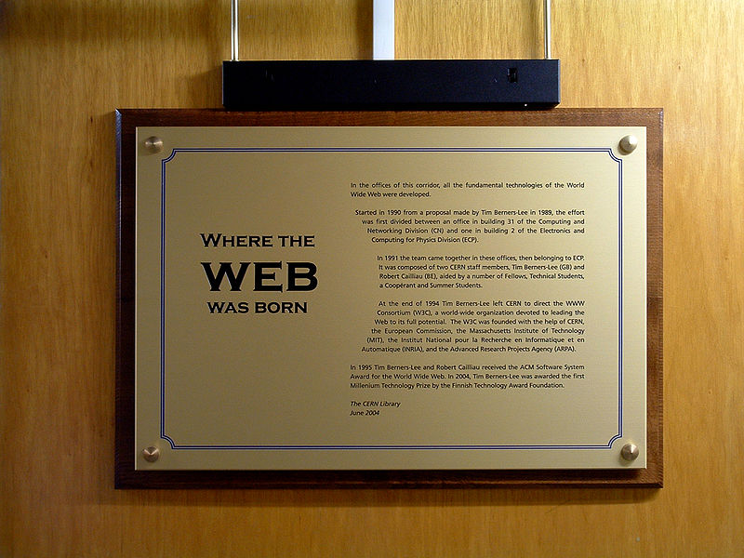
Theoretical Background of the Experiment
CERN
6/1/2017
Department of Computer Science and Engineering, GIT

Slide 6
Theoretical Background of the Experiment
CERN – Where the WEB was born by Max Braun
In the offices of this corridor, all the fundamental technologies of the World Wide Web were developed.
Started in 1990 from a proposal made by Tim Berners-Lee in 1989, the effort was first divided between an office in building 31 of the Computing and Network Division (CN) and one in building 2 of the Electronics and Computing for Physics Division (ECP).
In 1991 the team came together in these offices, then belonging to ECP. It was composed of two CERN staff members, Tim Berners-Lee (GB) and Robert Cailliau (BE), aided by a number of Fellows, Technical Students, a Coopérant and Summer Students.
At the end of 1994 Tim Berners-Lee left CERN to direct the WWW Consortium (W3C), a world-wide organization devoted to leading the Web to its full potential. The W3C was founded with the help of CERN, the European Commission, the Massachusetts Institute of Technology (MIT), the Institut National pour la Recherche en Informatique et en Automatique (INRIA), and the Advanced Research Projects Agency (ARPA).
In 1995 Tim Berners-Lee and Robert Cailliau received the ACM Software System Award for the World Wide Web. In 2004, Tim Berners-Lee was awarded the first Millenium Technology Prize by the Finnish Technology Award Foundation.
The CERN Library, June 2004
6/1/2017
Department of Computer Science and Engineering, GIT

Slide 7
Theoretical Background of the Experiment
Internet is:
A world-wide network of computer networks
At the lowest level, since 1982, all connections use TCP/IP
TCP/IP hides the differences among devices connected to the Internet
IETF - Internet Engineering Task Force
How many versions of TCP/IP protocols are present ?
RFC - Request for Comments
6/1/2017
Department of Computer Science and Engineering, GIT

Slide 8
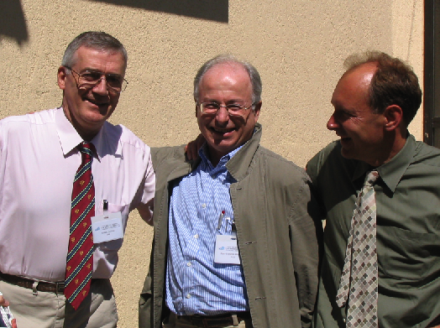
Theoretical Background of the Experiment
Cailliau , Abramatic, Berners Lee, 10 years WWW consortium by Robert Cailliau
6/1/2017
Department of Computer Science and Engineering, GIT

Slide 9
Theoretical Background of the Experiment
HTTP
Request
GET
POST
Response
Status
Content
[ Wireshark , Fiddler ]
6/1/2017
Department of Computer Science and Engineering, GIT

Slide 10


Structure of HTML
W3C Consortium - World Wide Web Consortium (W3C)
HTML5
W3C also oversee - CSS, SVG, WOFF, the Semantic Web stack, XML, and a variety of APIs.
[ Logos and Icons – W3C http://www.w3.org/Consortium/Legal/logo-usage-20000308.html
W3C - https://www.w3.org/html/logo/index.html ]
6/1/2017
Department of Computer Science and Engineering, GIT

Slide 11
Structure of HTML
Markup language.
Tags are elements of the HTML language.
Almost every kind of tag has an opening symbol and a closing symbol.
Attributes.
<HTML></HTML>
Element tells browsers that the file is a HTML document.
Each HTML document starts with the tag <HTML>.
This tag should be first thing in the document.
It has an associate closing tag </HTML> which must be the last tag in the file.
6/1/2017
Department of Computer Science and Engineering, GIT

Slide 12
Structure of HTML
<HEAD></HEAD>
The head contains important information about the document.
<TITLE></TITLE>
It is used to display a title on the top of browser window.
Both the opening and the closing tags go between the head tags.
6/1/2017
Department of Computer Science and Engineering, GIT

Slide 13

Structure of HTML
The head is used for text and tags that do not show directly on the page.
The body is used for text and tags that are shown directly on the page.
6/1/2017
Department of Computer Science and Engineering, GIT

Slide 14
Steps to render HTML document
1. Create a folder by your name in any directory
2. Open notepad | Notepad++ | Sublime Text | gedit
Save the file with .html extension
Type the HTML document and save
3. Right click on html fiel and select open with browser
or
Open the Internet Explorer | Firefox | Chrome web browser and type the URL as directoryname:\foldername\filename.html in the address bar
Ex: E:\cse\data.html
4. HTML page will render on browser
[ On Firefox or Chrome - Press F12 , explore !
Right click on web page and click View Source – What do you see ? ]
6/1/2017
Department of Computer Science and Engineering, GIT

Slide 15
HTML Example
example1.html <html> <head> <title>Homepage</title> </head> <body> </body> </html>
Department of Computer Science and Engineering, GIT

Slide 16
HTML Example
example1.html <html> <head> <title>Homepage</title> </head> <body> </body> </html> | example2.html <html> <body> <h1>My First Heading</h1> <p>My first paragraph.</p> </body> </html>
Department of Computer Science and Engineering, GIT

Slide 17
More Examples - heading
<html>
<body>
<h1>This is heading 1</h1>
<h2>This is heading 2</h2>
<h3>This is heading 3</h3>
<h4>This is heading 4</h4>
<h5>This is heading 5</h5>
<h6>This is heading 6</h6>
</body>
</html>
6/1/2017
Department of Computer Science and Engineering, GIT

Slide 18
More Examples – scrolling text
<html>
<body>
<marquee>This is scrolling text</marquee>
</body>
</html>
6/1/2017
Department of Computer Science and Engineering, GIT

Slide 19
Character Style
Character styles include physical and logical character styles, and Face, Size, and Color.
Following is character style table.
Physical styles:
<b> | Make text bold.
<i> | Make text italic.
<u> | Make text underline.
<strike> | Make text strikethrough.
<sup> | Make text ^{superscript}.
<sub> | Make text _{subscript}.
teletype | Make text teletype
6/1/2017
Department of Computer Science and Engineering, GIT

Slide 20
Character Style
<strong> | Indicate the text is very important.
<em> | Indicate the text is important.
<cite> | Indicate that the text is from a book or other document.
<address> | Indicate that the text is an address.
<dfn> | Indicate that the text is a definition.
<samp> | Indicate that the text is a sequence of literal characters.
Keyboard | Indicate that the text is keyboard input.
<var> | Indicate that the text is a variable.
<code> | Indicate that the text is code.
Logical styles:
6/1/2017
Department of Computer Science and Engineering, GIT

Slide 21
More Examples – HTML5 , XHTML
Stricter Markup language
<!-- For HTML5 , include DOCTYPE as first line -->
<!DOCTYPE html PUBLIC "-//W3C//DTD XHTML 1.0 Transitional//EN" "http://www.w3.org/TR/xhtml1/DTD/xhtml1-transitional.dtd">
<!-- For , XHTML - subset and extends HTML4 -->
<!-- The root element of an XHTML document must be html -->
<!-- Must contain an xmlns attribute to associate it with the XHTML namespace. -->
<html xmlns = ″http://www.w3.org/1999/xhtml″>
Department of Computer Science and Engineering, GIT

Slide 22
More Examples – anchor , hyperlink
<!-- link.html An example to illustrate a link -->
<html xmlns = ″http://www.w3.org/1999/xhtml″>
<head> <title> Links </title>
</head>
<body>
<h1> Aidan's Airplanes </h1>
<h2> The best in used airplanes </h2>
<h3> "We've got them by the hangarful"
</h3>
<h2> Special of the month </h2>
<p> 1960 Cessna 210 <br /> <a href = "C210data.html">
Information on the Cessna 210 </a>
</p>
</body>
</html>
Department of Computer Science and Engineering, GIT

Slide 23
More Examples - image
<!-- An example to display image -->
<html>
<body>
<h2>Spectacular Mountain</h2>
<!-- image pic_mountain.jpg should be in same folder -->
<!-- as the html page , else mention -->
<!-- either relative or absolute path -->
<!-- No image in system ? Take Print Screen ! -->
<img src="pic_mountain.jpg" alt="Mountain View” />
</body>
</html>
Department of Computer Science and Engineering, GIT

Slide 24
More Examples - image
<!-- An example to display image -->
<html>
<body>
<h2>Spectacular Mountain</h2>
<img src="pic_mountain.jpg" alt="Mountain View”
width="128" height="128" />
</body>
</html>
Department of Computer Science and Engineering, GIT

Slide 25
More Examples - list
<!-- An example to ordered list -->
<html>
<body>
<h2> Ordered List </h2>
<ol>
<li>Coffee</li>
<li>Tea</li>
<li>Milk</li>
</ol>
<!-- Now for unordered list? -->
</body>
</html>
Department of Computer Science and Engineering, GIT

Slide 26
More Examples - table
<html>
<body>
<h2>HTML Tables</h2>
<p>HTML tables start with a table tag.</p>
<p>Table rows start with a tr tag.</p>
<p>Table data start with a td tag.</p>
<hr>
<h2>1 Column:</h2>
<table>
<tr>
<td>100</td>
</tr>
</table>
</body>
</html>
Department of Computer Science and Engineering, GIT

Slide 27
More Examples - table
<html>
<body>
<h2>HTML Tables</h2>
<p>HTML tables start with a table tag.</p>
<p>Table rows start with a tr tag.</p>
<p>Table data start with a td tag.</p>
<hr>
<h2>1 Column:</h2>
<table>
<tr>
<td>100</td>
</tr>
</table>
<!-- How about 1 Row and 3 Columns ? -->
</body>
</html>
Department of Computer Science and Engineering, GIT

Slide 28
More Examples - table
<html>
<body>
<h2>HTML Tables</h2>
<p>HTML tables start with a table tag.</p>
<p>Table rows start with a tr tag.</p>
<p>Table data start with a td tag.</p>
<hr>
<h2>1 Column:</h2>
<table>
<tr>
<td>100</td>
</tr>
</table>
<hr>
<h2>1 Row and 3 Columns:</h2>
<table>
<tr>
<td>100</td>
<td>200</td>
<td>300</td>
</tr>
</table>
<hr>
</body>
</html>
Department of Computer Science and Engineering, GIT

Slide 29
More Examples - table
<html>
<body>
<h2>HTML Tables</h2>
<p>HTML tables start with a table tag.</p>
<p>Table rows start with a tr tag.</p>
<p>Table data start with a td tag.</p>
<hr>
<h2>1 Column:</h2>
<table>
<tr>
<td>100</td>
</tr>
</table>
<hr>
<h2>1 Row and 3 Columns:</h2>
<table>
<tr>
<td>100</td>
<td>200</td>
<td>300</td>
</tr>
</table>
<!-- Now how about 3 Row and 3 Columns ? -->
<hr>
</body>
</html>
Department of Computer Science and Engineering, GIT

Slide 30
More Examples - table
<html>
<body>
<h2>HTML Tables</h2>
<p>HTML tables start with a table tag.</p>
<p>Table rows start with a tr tag.</p>
<p>Table data start with a td tag.</p>
<hr> <h2>1 Column:</h2>
<table>
<tr>
<td>100</td>
</tr>
</table>
<hr>
<h2>1 Row and 3 Columns:</h2>
<table>
<tr>
<td>100</td>
<td>200</td>
<td>300</td>
</tr>
</table>
<hr>
<h2>3 Rows and 3 Columns:</h2>
<table>
<tr>
<td>100</td>
<td>200</td>
<td>300</td>
</tr>
<tr>
<td>400</td>
<td>500</td>
<td>600</td>
</tr>
<tr>
<td>700</td>
<td>800</td>
<td>900</td>
</tr>
</table>
<hr>
</body>
</html>
Department of Computer Science and Engineering, GIT

Slide 31
Learning Outcomes of the Experiment
At the end of the session, students should be able to :
1. Understand the working of Client and Server.
2. Write and display simple HTML programs.
6/1/2017
Department of Computer Science and Engineering, GIT

